Slide 1
Microservices Configuration Management

Slide 2




Session Ground Rules
Today’s session will be recorded and posted for future reference.
If you are not comfortable participating in a recorded call, please drop now.
We will present first, then have a ~20 minute Q&A segment at the end.
Please hold your questions until we reach the Q&A segment.
You may post forum questions during the call here.

Slide 3







Microservices "Get the Facts!" Webcast Series
What is a Microservice? — Learn about the 10 principles and their criticality to success
Design First— Learn how the single capability focused and encapsulation principles are key and design guidelines for success
Sticks and Stones — Building Microservices Using Pattern-aligned Templates
Pipes and Gates — How to use Continuous Deployment Pipelines to Automated End to End Delivery
Streams and Events — How to Keep Up with a Decomposed Microservice Universe using Logging and Monitoring Platform Components
Open Forum — a special session that will be driven by feedback from our first 5 sessions on topics of interest to the community
Configuration Management (Today!) - How to configure, localize and tune Microservices deployed on the CDP platform
http://microservices.web.att.com
Join and follow the Microservice Community here
Checkout the Microservice documentation Wiki here
Follow the Microservices TechDev Community Blog for Upcoming Session Schedule!

Slide 4




agenda
Introduction
Continuous Deployment Platform (CDP)
Process
Q&A

Slide 5
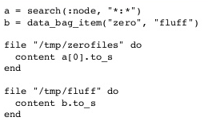



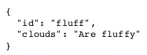
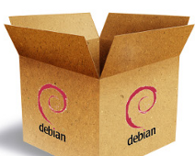
Introduction: Configuration Management
Introduction
CDP
Process
Why Use Configuration Management?
Ensure availability of the functional attributes/properties across environments.
Have control on who can make what changes
Record who changed what, why, when
Ability to view what configurations will/have been applied
Ability to define configurations at various levels to avoid redundancy
Localization context
SDLC env
Geoloc…
Variables
Configuration Logic
Artifacts
+
+
Artifact Repository
Runtime Fabric
= Namespace Boundary

Slide 6







What is Continuous Deployment Platform (CDP)?
Introduction
CDP
Process
Core capabilities provide reusability & consistency across all delivery roles & a true DevOps experience
Technical platform for delivering cloud-agnostic Microservices!
Reusable Template Catalog
Automated CI/CD Pipeline
Runtime Application Fabric
Searchable Reusability
Self-Service Onboarding
Automated
Consistent experience
Full lifecycle automation
Human gate approvals
Enables DevOps culture
Secure
Highly resilient
Automated deployment
Dynamic scaling
Continuous Integration/Delivery
Optional Gate
Approval
Runtime Fabric
Site 1
Site 2-n…
Node
Node
Node

Slide 7


Configuration Management through Continuous Deployment Platform
Introduction
CDP
Process
Reusable Template Catalog
Automated CI/CD Pipeline
Runtime Application Fabric
Provides Variablized Templates
Dynamic config change absorption code
BAU delivery of configurations
Allow overriding configurations
Enables DevOps culture
Configuration available to running software
Allow overriding of BAU process
Fully support native tooling/CLIs. (kubectl)
CI/CD
Optional Gate Approval

Slide 8
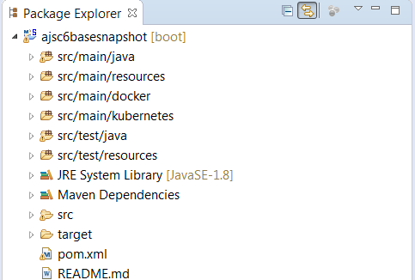



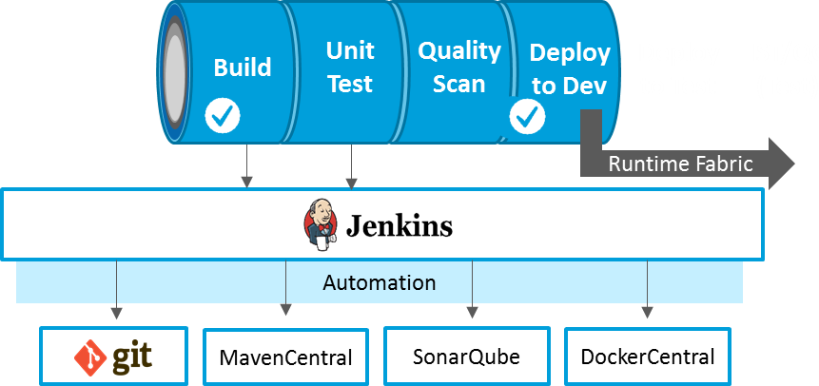

Introduction
CDP
Process
Microservice Creation: What is created on Generate?
Template Catalog
Browse Catalog
Generate Project
Project Code in Code Cloud
1
Dev Team
Generated Microservice Code
Pipeline instance
2
Triggers CI/CD Process
Runtime Application Fabric
Automated testing
5
Deployed service running in container
Deploys to Fabric
3
Jenkins Automation Script
Runtime Fabric
Site 1
Site 2-n…
Node
Node
Node
4
Docker image
Automated Delivery Pipeline

Slide 9
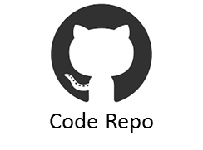
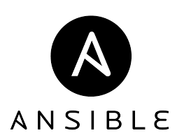

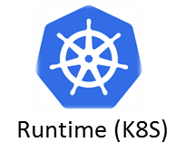
Configuration Management Process
Introduction
CDP
Process
Configuration Pipeline
1
Configuration Staging
2
Effective Configuration Calculation
Gate
Approval
SWM
Variable Assignment
Define
Artifact Repository
Calculate
Microservice Code Repo
Default Configurations
Configuration Repo
Overridden Configurations
Config
Services
Effective
Configs
Apply
Kubectl
Config Maps
Secrets
3
Apply Configuration per context

Slide 10
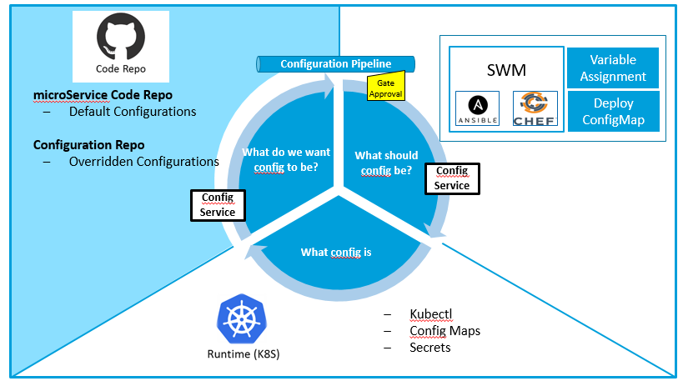
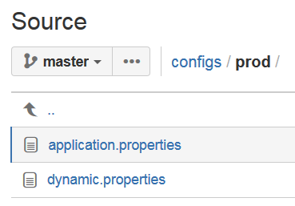
Define Configuration
Introduction
CDP
Process
Define
Branch the config directory
Override the configs
Review the changes
Approve Changes
Merge to master
View Configurations
Start of the process
Override Configurations

Slide 11
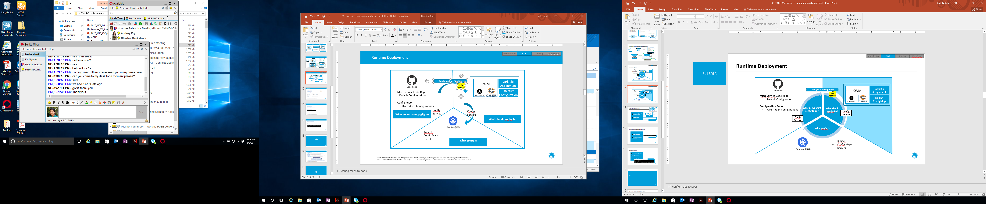
Calculate Configuration
Introduction
CDP
Process
Calculate
Supply configurations
Compute Effective configs
Native tooling like Knife
View Configurations
Native tooling like Knife
Override Configurations

Slide 12
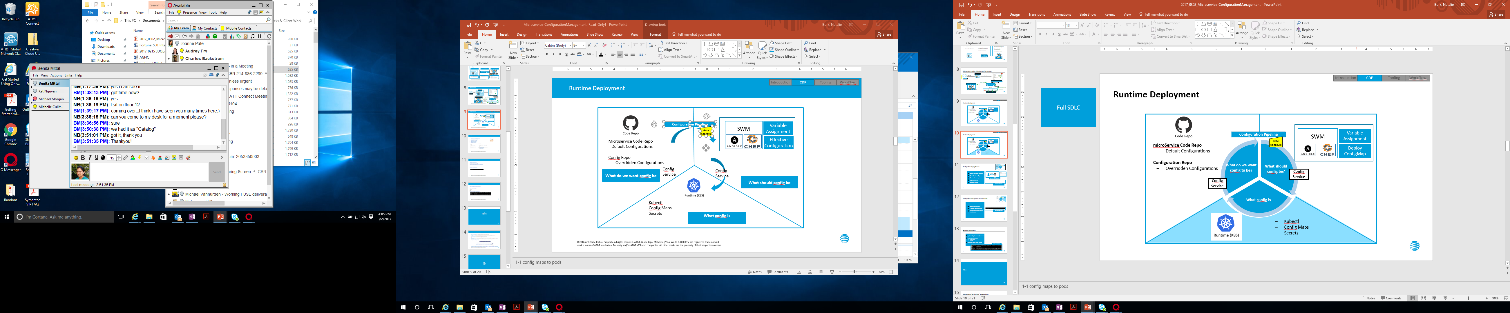
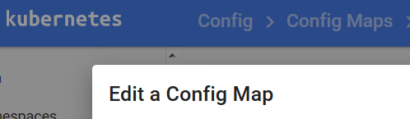
Apply Configuration
Introduction
CDP
Process
Apply
Apply Configs to running instances
Update configMaps
Update Secrets
Tag Effective configurations in codecloud
Native tooling like Kubectl , K8S Dashboard
View Configurations
Native tooling like Kubectl , K8S Dashboard
Override Configurations

Slide 13
Attributes
Introduction
CDP
Process
Configuration context:
Environment: Dev, Test, Prod
Geo-Location: Bothell, Dallas …
Software Configuration can be overridden in production
{
“max_conns”: 10,
“db_url”: dbhost.hydc.:1531
}
override
Software Configuration normally override defaults with contextualized values
{
“max_conns”: 100,
“db_url”: dbhost.hydc.:1531
}
Normal
{
“max_conns”: 1,
“db_url”: localhost:1531
}
Example:
A test instance of service in Dallas is configured to connect to the test instance of the DB that is closest to it geographically.
Developer Includes Default Configuration
Default

Slide 14
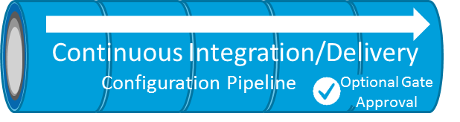
Simplified Development Process
Introduction
CDP
Process
Developer
Define
Apply
Daniel defines the configurations
Sets the default value for the property
dbUrl=http://
Deploys service in K8S
Spins up an instance with dbUrl=http://

Slide 15
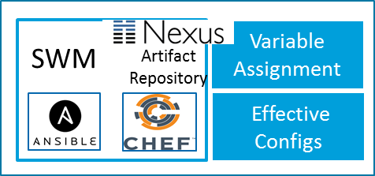
Normal multi-environment Process
Introduction
CDP
Process
Operations wants to configure per localization context
Define
Calculate
Apply
Bob creates a branch
Bob changes the configuration
Changes db_Url=http://dbprod.att.com
Bob submits for review
John approves the changes
Bob merge the branch to master
Check what should be the value applicable to node
Determines the effective value
Update config Map in K8S
Changes db_Url=http://dbprod.att.com
Running Instance absorbs the change
Tag the configuration in codecloud

Slide 16
Emergency configuration management
Introduction
CDP
Process
Use Native tooling to apply configuration directly.
Apply
Bob Updates the configMap
Changes are absorbed by the running instance
Bob checks in the change he made into codecloud

Slide 17
Q&A

Slide 18
Microservices "Get the Facts!" Webcast Series
What is a Microservice? — Learn about the 10 principles and their criticality to success
Design First— Learn how the single capability focused and encapsulation principles are key and design guidelines for success
Sticks and Stones — Building Microservices Using Pattern-aligned Templates
Pipes and Gates — How to use Continuous Deployment Pipelines to Automated End to End Delivery
Streams and Events — How to Keep Up with a Decomposed Microservice Universe using Logging and Monitoring Platform Components
Open Forum — a special session that will be driven by feedback from our first 5 sessions on topics of interest to the community
Configuration Management (Today!) - How to configure, localize and tune Microservices deployed on the CDP platform
http://microservices.web.att.com
Join and follow the Microservice Community here
Checkout the Microservice documentation Wiki here
Follow the Microservices TechDev Community Blog for Upcoming Session Schedule!

